Slide 1
Eve Online Marketplace
(EOM)
Presentation by:
Siming Jia & Trey Lemons

Slide 2

What is EOM?
Eve Online Marketplace is a third party application that would work alongside the game Eve Online. This marketplace allows users of the game to sign up and then use the marketplace. As a buyer, you have the ability to view sell orders or create a buy order of items that you want to buy. From the seller’s view, they have the ability to put up sell orders for buyers to see.

Slide 3
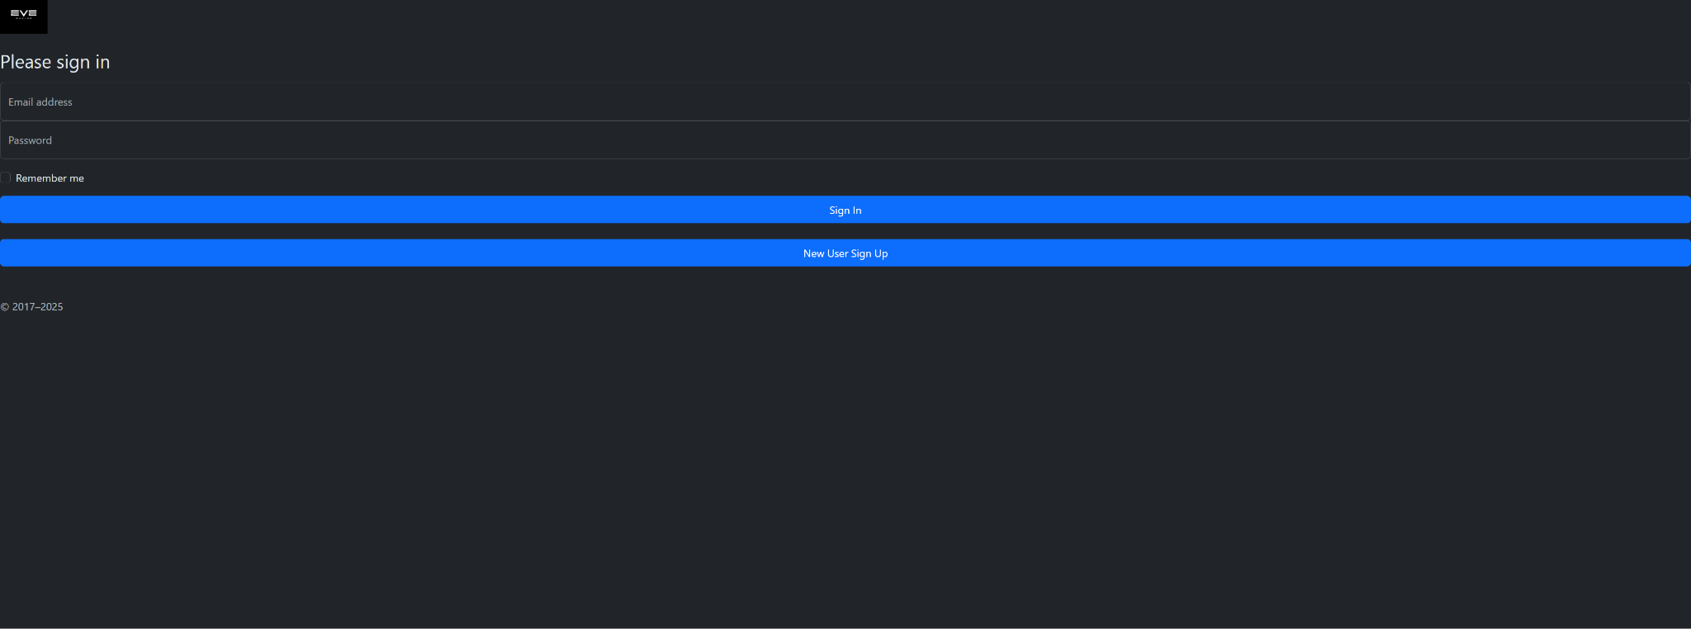
Homepage: index.html
This is the first page users will see when connecting, it is a sign in screen with the option to sign in or to sign up if you’re a new user.
This page ensures only users of the game are allowed in to keep fraudulent orders out of the app.

Slide 4
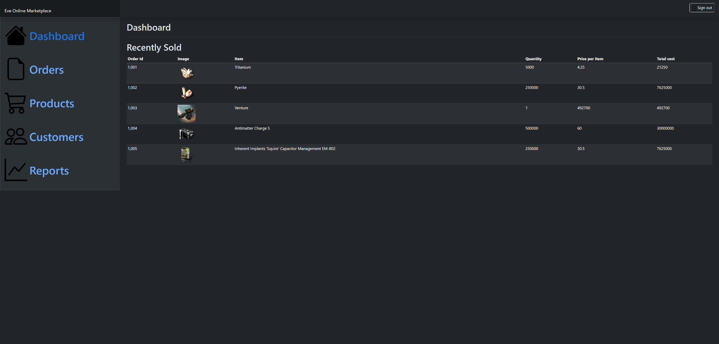
The Dashboard and Features
The dashboard is the main hub after a user has logged in. There is only one log in for both buyers and sellers since buyers are also available to sell items as well. On the dashboard we see a list of buttons that take you to specific places within the app to buy or look at reviews or seller information. This is available on every page AFTER the Sign in screen.

Slide 5
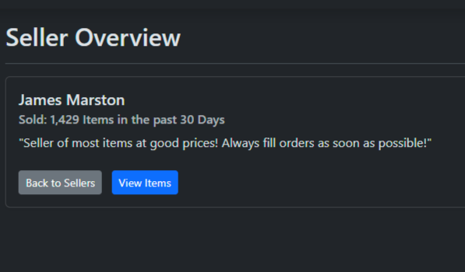
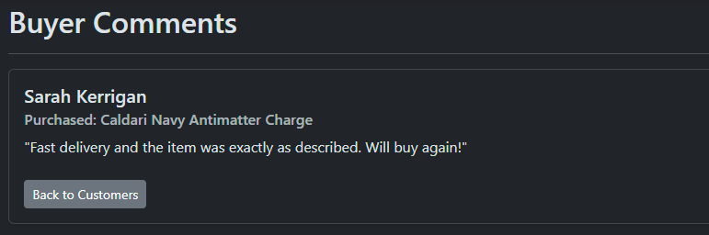
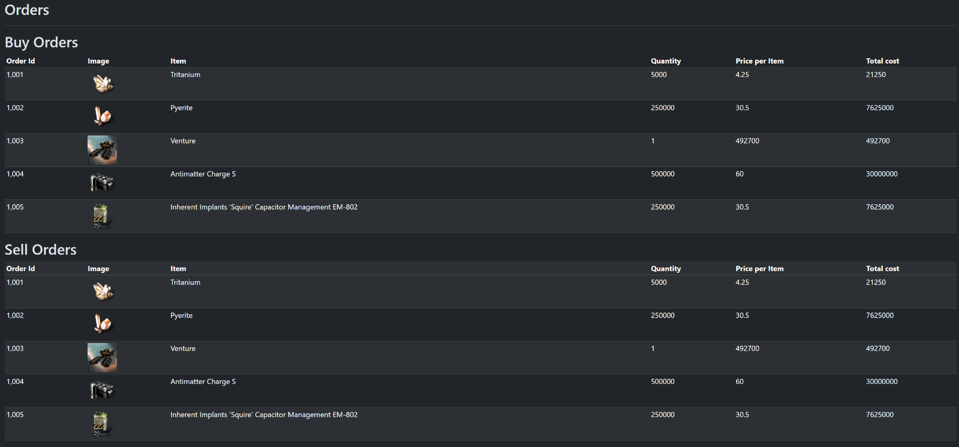
Other Features
You are able to view sellers along with their reliability in the Reports tab, similar to how see Customers and their reviews in the Customers tab.
The Products tab shows the user specific items that are available and upon clicking add item would add it to your specific buy order.
The Orders tab is a list of sell and buy orders people have placed for either users to buy or to fill the orders.

